Slide 1
ML4A Project: ASHRAE Dataset
Students
Taras Kutsyk
Anastasiia Bondarenko
Supervisor
Prof. Alessandro D'Innocenzo

Slide 2
Table of contents
Introduction to the ASHRAE dataset
Problem formulation
Preprocessing of the dataset
Lag matrix & Forecast matrix
Models we used
Validation results
Results discussion

Slide 3

ASHRAE dataset: introduction
ASHRAE is an American association that focuses on building systems & energy efficiency. In 2019, it provided a dataset to be used in a Kaggle competition for building ML models to predict metered building energy usage in the following areas: chilled water, electric, hot water, and steam meters.
The data comes from over 1,000 buildings over a three-year timeframe.

Slide 4
ASHRAE dataset: structure
train.csv
building_id - Foreign key for the building metadata
timestamp - When the measurement was taken
meter - The meter id code. Read as {0: electricity, 1: chilledwater, 2: steam, 3: hotwater}
meter_reading - The target variable. Energy consumption in kWh (or equivalent).
building_meta.csv
building_id - Foreign key for training.csv
site_id - Foreign key for the weather files.
primary_use - Indicator of the primary category of activities for the building based on EnergyStar property type definitions
square_feet - Gross floor area of the building
year_built - Year building was opened
floor_count - Number of floors of the building
building_meta.csv
site_id - Foreign key for the weather files.
building_id - Foreign key for training.csv
primary_use - Indicator of the primary category of activities for the building
square_feet - Gross floor area of the building
year_built - Year building was opened
floor_count - Number of floors of the building

Slide 5
Problem formulation
Task #1:
Predict an outside temperature after N hours (N = 1, 2, …, 24), given the lags of energy usage, outside temperature and weather data (forecast).
Task #2:
Predict an energy consumption given the lags of weather data, building metadata and, optionally, the lags of energy consumption.

Slide 6
Dataset preprocessing
We preprocessed the dataset to resolve its 2 main challenges:
Number of missing records
The dataset length
In the initial format, the dataset contained over 20 million records, which was infeasible for the most models to handle, given the computational recourses we had available (and considering that we had to fit each model 24 times for Task #1).

Slide 7
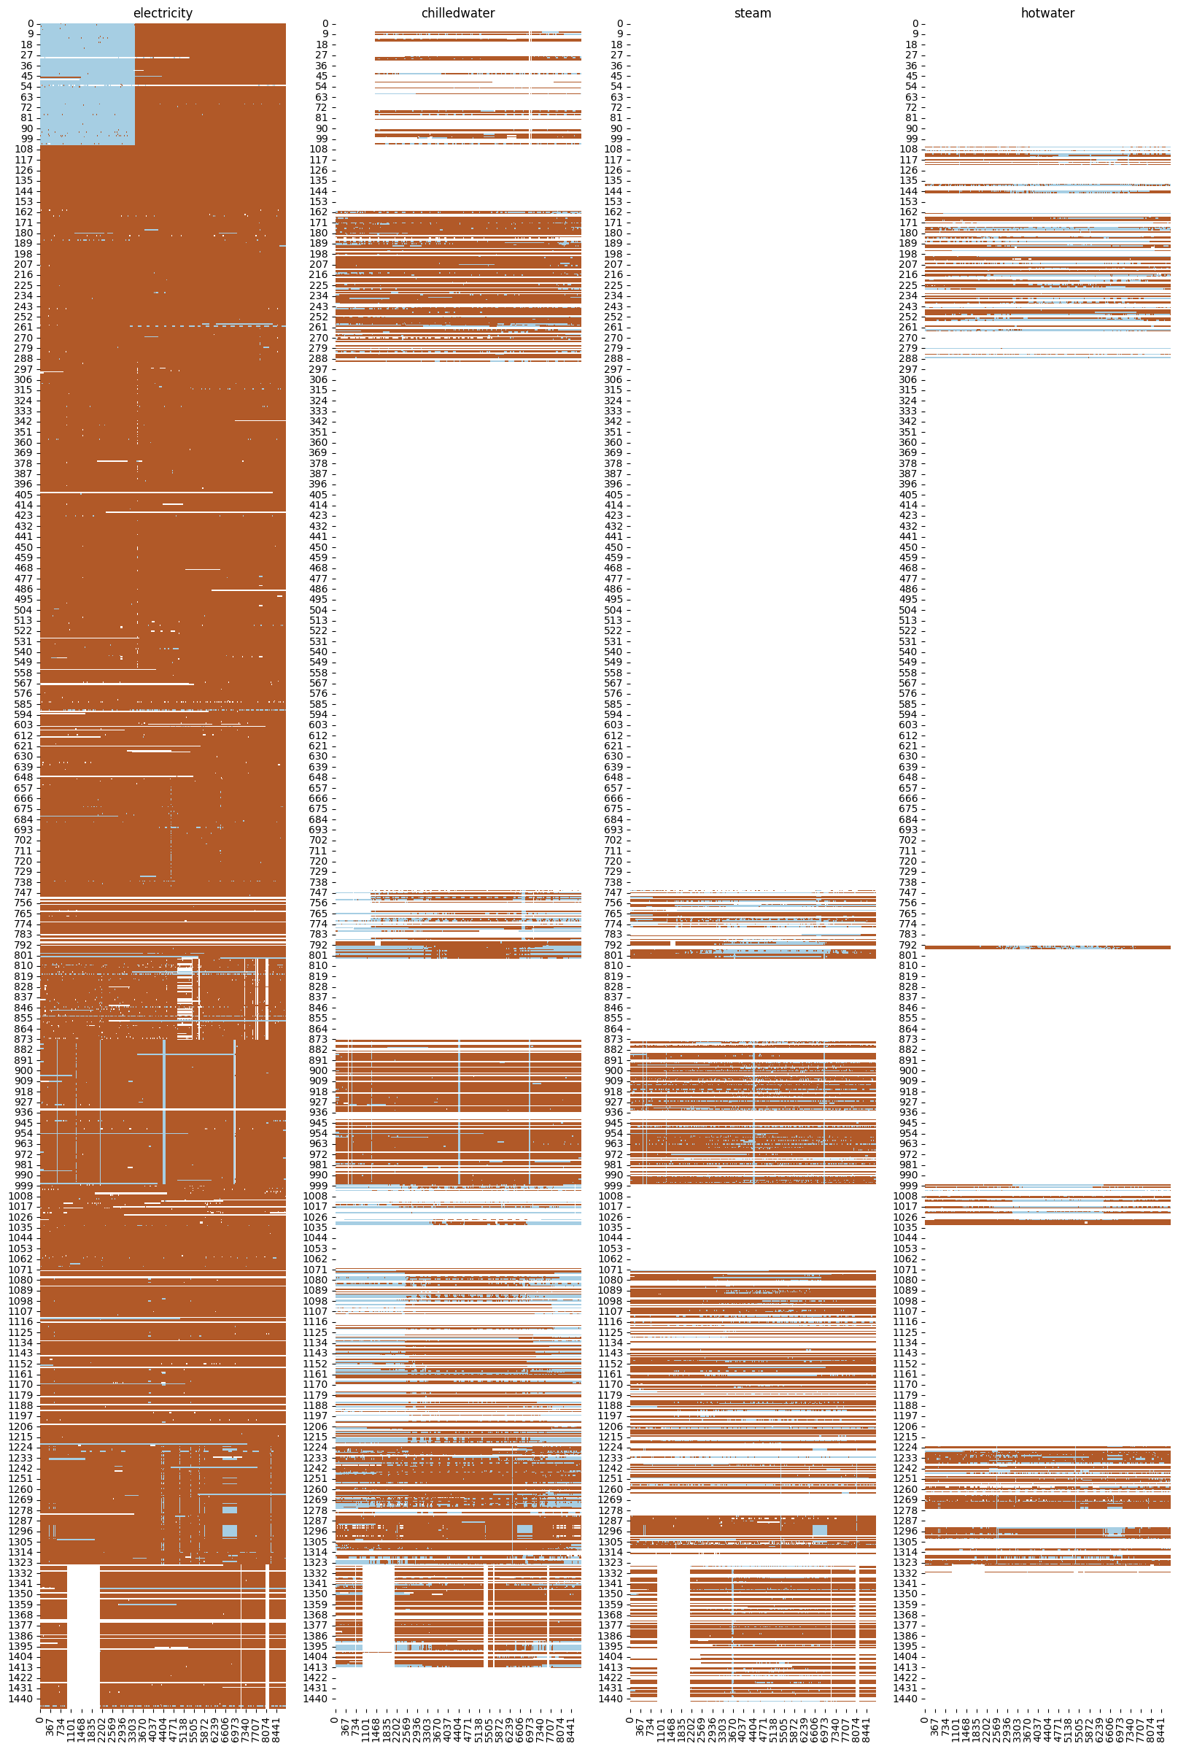
Missing records
On the right you can see a heatmap of time vs. presence of records for each building.
Legend:
X axis: hours elapsed since the beginning of the dataset
Y axis: building_id
Brown: meter reading available with non-zero value
Light blue: meter reading available with zero value
White: missing meter reading

Slide 8
Main preprocessing steps
Include records only for the electricity meter (which contains the most data).
Resample the dataset to 1-hour frequency:
Some buildings contained too little data to apply resampling, so we discard them first.
Resample the records for the remaining buildings using linear interpolation.
Select a random subsample of the remaining buildings.
Clean NaNs: impute the missing values with the corresponding median values.
Add some time-related features, such as hour of the day etc.
Split the dataset into the training (75%) and testing (25%) sets based on the time period: May, August and November went to the testing set, and everything else was left for the training.

Slide 9
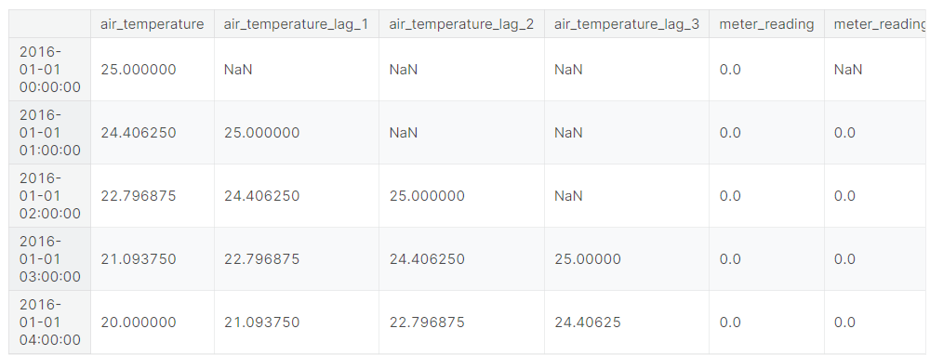
Lag matrix & Forecast matrix

Slide 10
Models
Dataset Size:
training: 276191 samples
testing: 92735 samples
Models:
Linear Models
Linear Regressor
Ridge
Lasso
Passive Aggressive Regressor
SGD Regressor
Decision Tree Regressor
Random Forest Regressor
Dataset Size:
training: 6568 samples
testing: 2200 samples
Models:
Linear Models
Linear Regressor
Ridge
Lasso
Passive Aggressive Regressor
SGD Regressor
Kernel Ridge
SV Regressor
Decision Tree Regressor
Random Forest Regressor

Slide 11
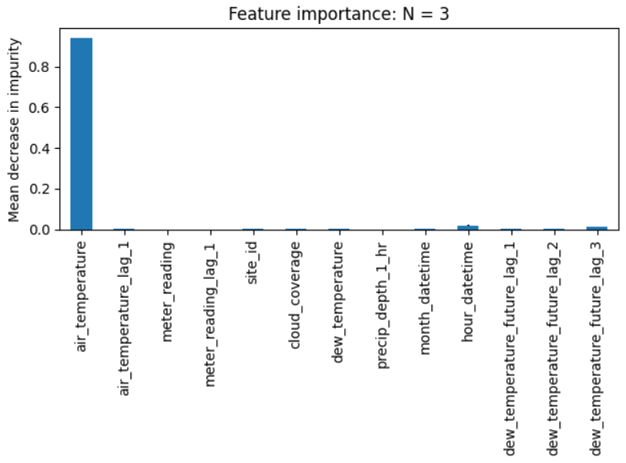
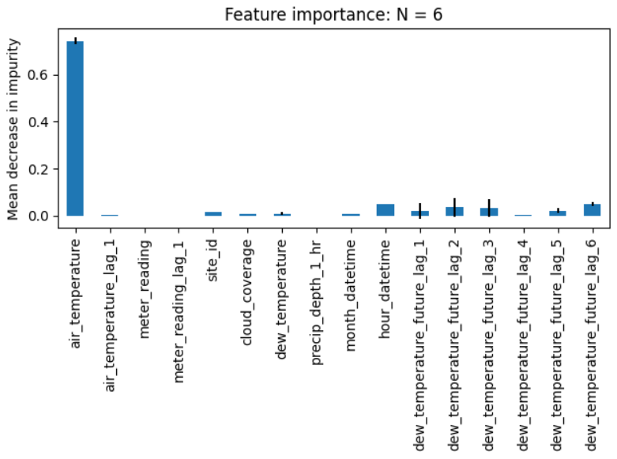
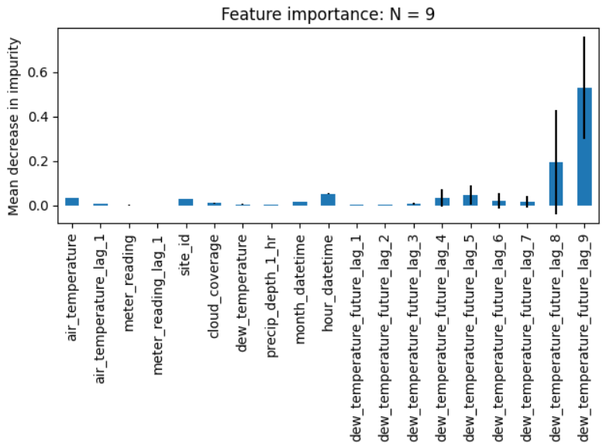
Task #1(big dataset): Feature importance

Slide 12
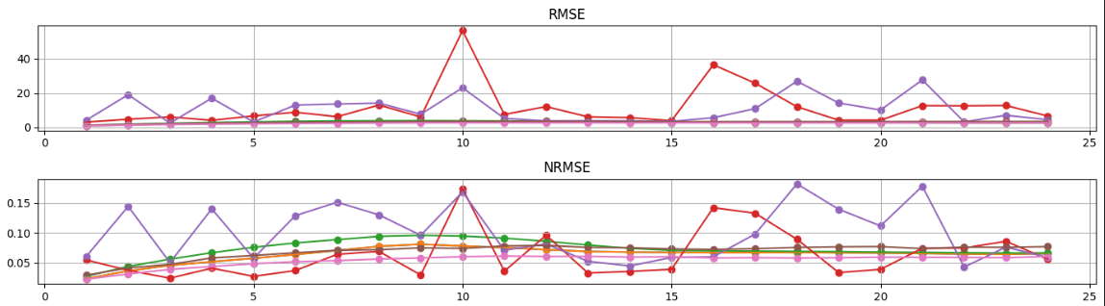
NRMSE
RMSE
Model / Lags | 2 | 4 | 6 | 8
Linear Regression | 3.15 | 3.031 | 2.903 | 2.772
Ridge | 3.15 | 3.031 | 2.903 | 2.772
Lasso | 3.317 | 3.187 | 3.099 | 2.979
Passive Aggressive Regression | 11.462 | 10.471 | 9.733 | 11.596
SGD Regression | 5.35 | 6.876 | 8.034 | 10.333
Decision Tree | 3.171 | 3.137 | 3.123 | 3.091
Random Forest | 2.474 | 2.446 | 2.416 | 2.38
Model / Lags | 2 | 4 | 6 | 8
Linear Regression | 0.072 | 0.068 | 0.065 | 0.064
Ridge | 0.072 | 0.068 | 0.065 | 0.064
Lasso | 0.08 | 0.077 | 0.075 | 0.073
Passive Aggressive Regression | 0.084 | 0.067 | 0.061 | 0.064
SGD Regression | 0.087 | 0.091 | 0.092 | 0.099
Decision Tree | 0.071 | 0.07 | 0.069 | 0.069
Random Forest | 0.057 | 0.056 | 0.055 | 0.054

Slide 13
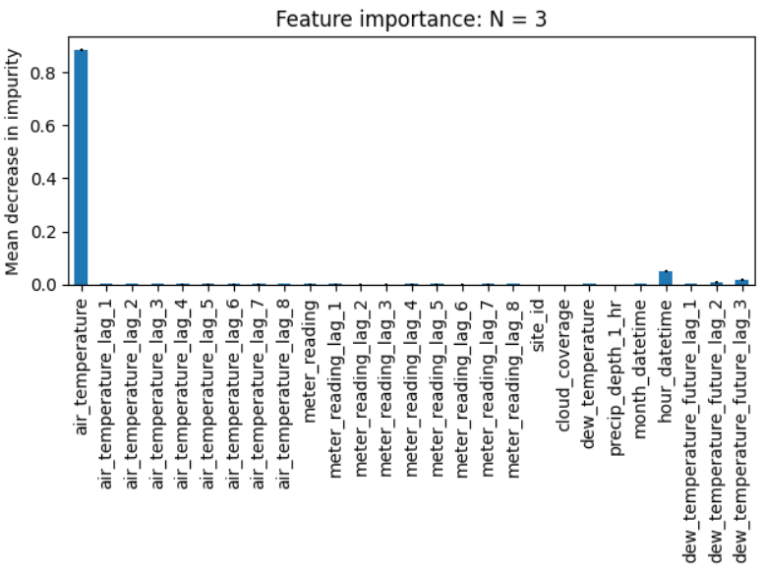
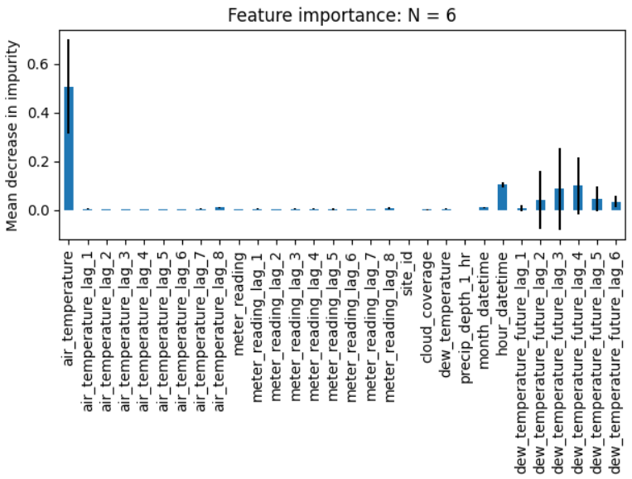
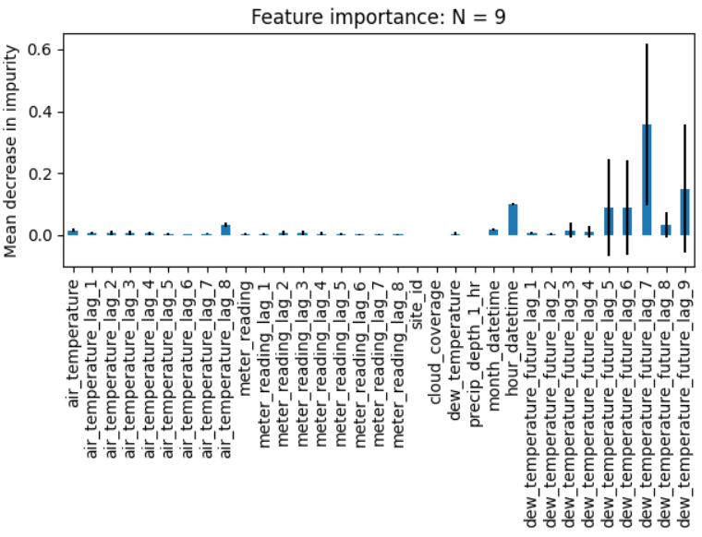
Task #1(small dataset): Feature importance

Slide 14
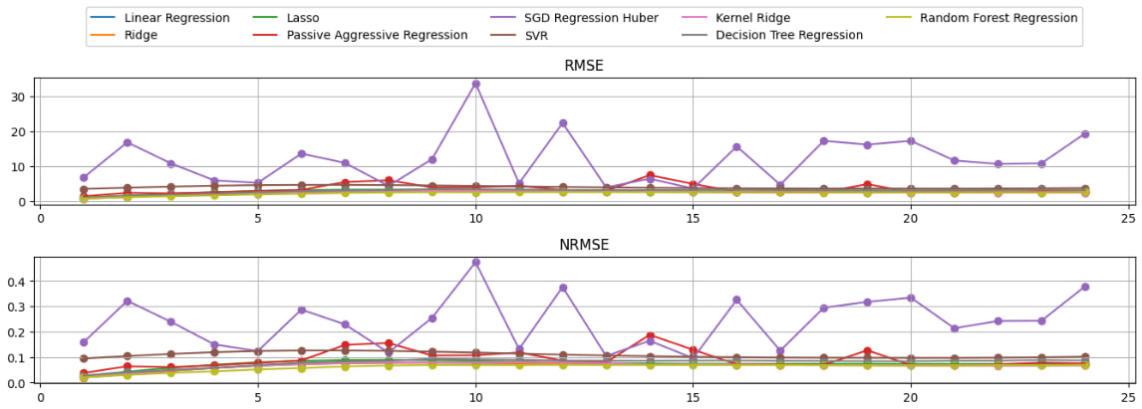
Task #1(small dataset): Errors
Lags = 8

Slide 15
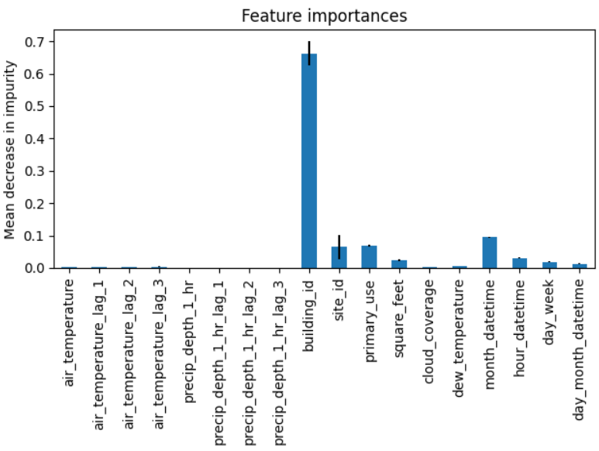
Task #2: Feature importance
Dataset size:
Training: 276191
Testing: 92735

Slide 16
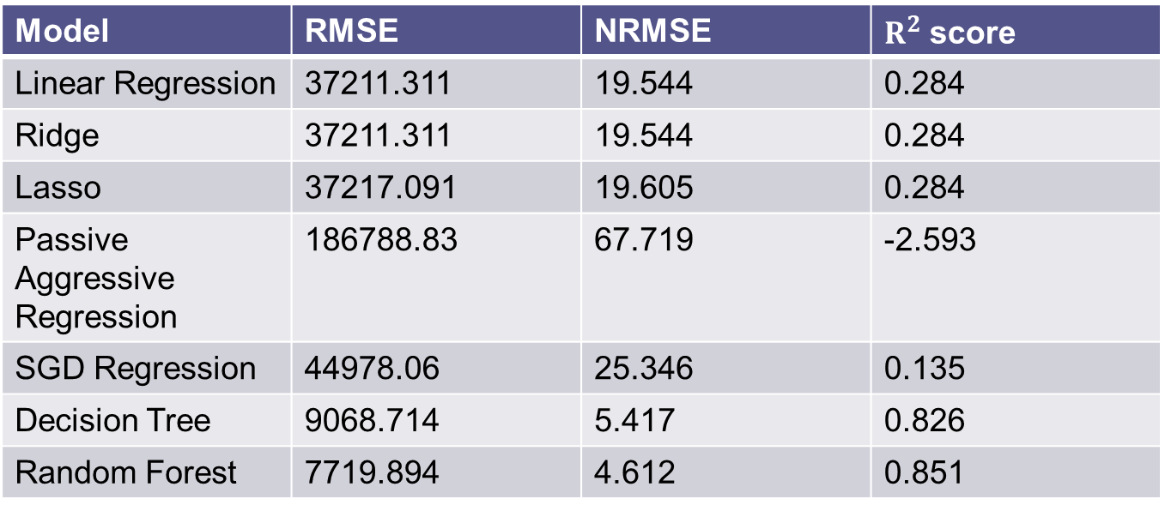
Task #2: Errors
Model | RMSE | NRMSE | $R^{2}$ score
Linear Regression | 37211.311 | 19.544 | 0.284
Ridge | 37211.311 | 19.544 | 0.284
Lasso | 37217.091 | 19.605 | 0.284
Passive Aggressive Regression | 186788.83 | 67.719 | -2.593
SGD Regression | 44978.06 | 25.346 | 0.135
Decision Tree | 9068.714 | 5.417 | 0.826
Random Forest | 7719.894 | 4.612 | 0.851

